Slide 1
Microservices and DevOps
DevOps and Container Technology
A Jenkins Experiment from 2017
Henrik Bærbak Christensen

Slide 2
Goal
To get dirty hands on using a build server system for
Continuous integration
Unit testing, real integration testing (accept test/service test/end-to-end test) using live services
Continuous deployment
Packing services into containers (Docker images)
Map conceptual framework to real system
Pipeline, stages, resources, …

Slide 3
Learning Process
Tried Concourse
Simple model
Tasks, Resources, Jobs
Failed, did not solve issues with security (timeboxing limit)
Tried Jenkins
Big pile of mud model
Two UIs,
Two different approaches for defining pipelines (UI / Jenkins file)
Two variants of syntax for pipelines in Jenkins files
Unholy mix of special syntax and plain old bash scripts
But – made it work!

Slide 4
First Light
Goal 1: Compile and unit-test TS17* in Jenkins
*) TS17 is a RSA case study system

Slide 5
Mise en Place
To cook that up, we need
A running Jenkins server
Telling Jenkins to
Checkout my TS17D source code (SSH git, means keys)
Compile and unit test it (‘gradle test’)
The Ingrediens
Start a Jenkins server (easiest using a docker hub image)
Jenkins require an agent (~ a machine/node) as execution context
Modern default is a docker container
Configure with secure key for SSH to ‘git clone’

Slide 6
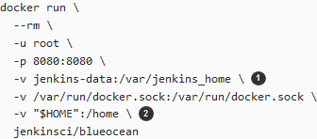
Jenkins in a Container
Find some spare CPU/RAM/Disk and use a containerized Jenkins.
I took my starting point in
https://jenkins.io/doc/tutorials/build-a-java-app-with-maven/
Better:
-v ~/jenkins-data:/var/jenkins_home

Slide 7
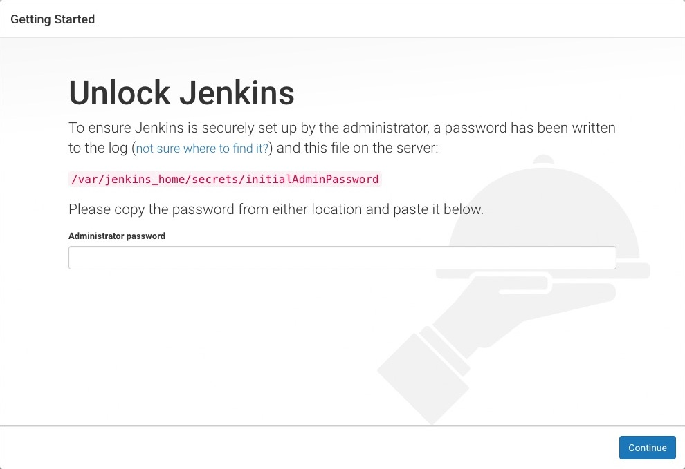
Unlocking
You need to unlock it, follow the tutorial
Note: If you restart the container before it is entered, you are deadlocked.

Slide 8
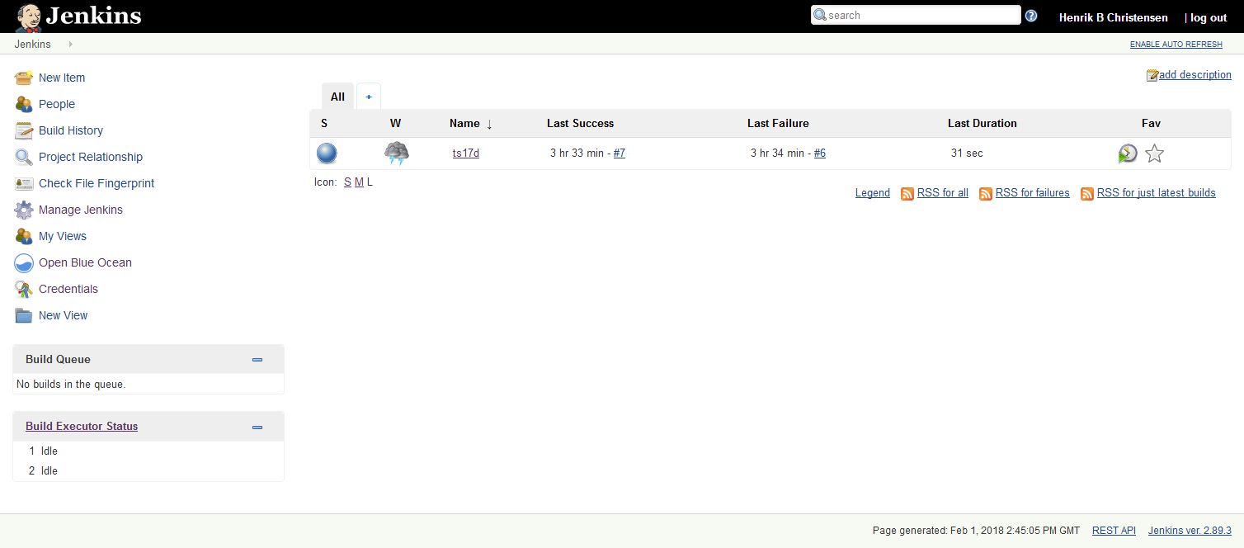
Dashboard

Slide 9
Secure Key
Usual frustration…
Need to provide the private key when checking out of bitbucket

Slide 10
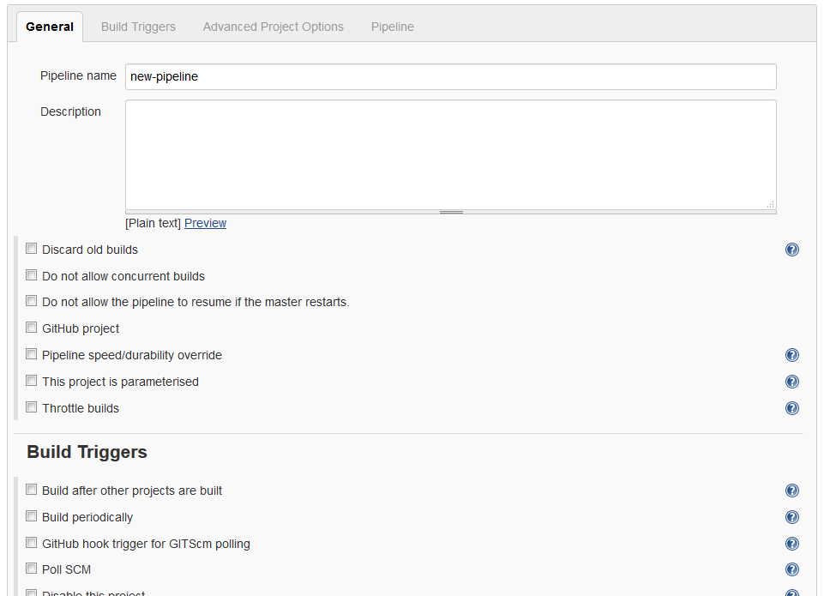
Define a Pipeline

Slide 11
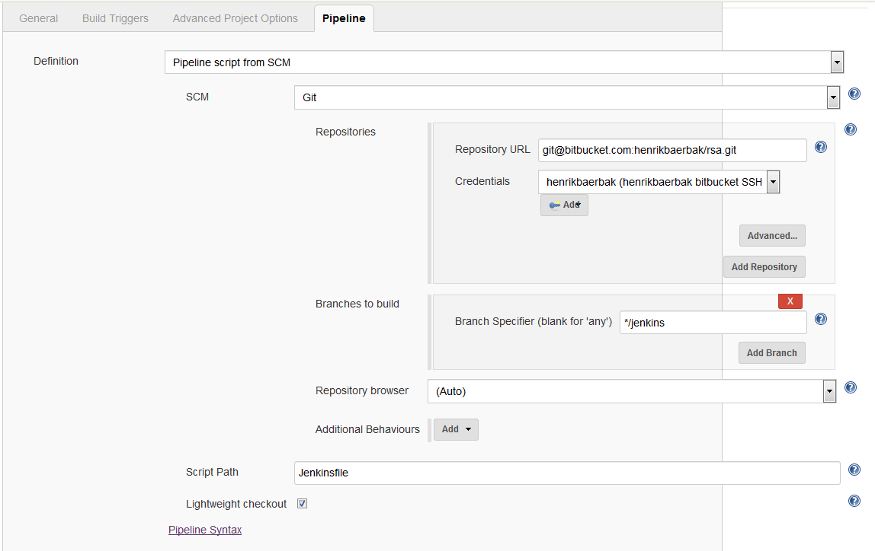
Jenkinsfile under SCM

Slide 12
SCM Monitoring
Rightclick pipeline name and choose ‘configure’
Poll SCM To run the pipeline every 5 minutes
H/5 * * * * = poll every 5 minutes (randomly distribution)
Will poll, and only rerun pipeline in case of changes!
I do not think you can trigger builds if your Jenkins is locally installed
POST from bitbucket to local IP? Nay…

Slide 13
Pipeline
About 69 commits later (Sigh!)…
Commit stage, Accept stage

Slide 14
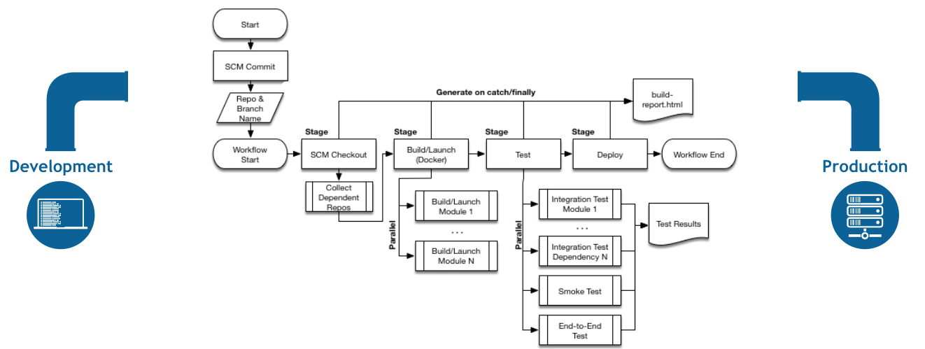
Workflow
https://jenkins.io/doc/book/pipeline/

Slide 15
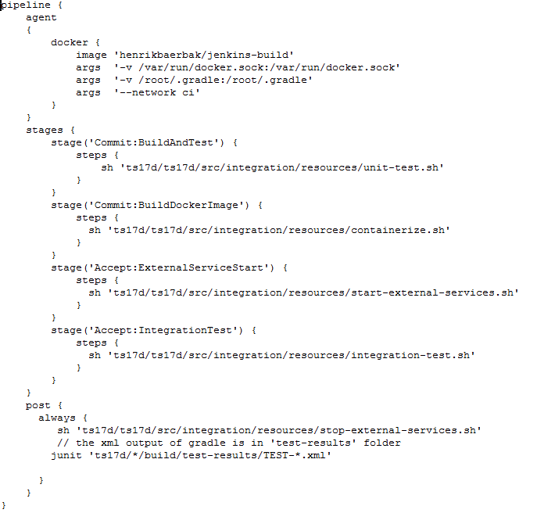
Jenkinsfile

Slide 16
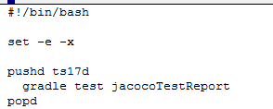
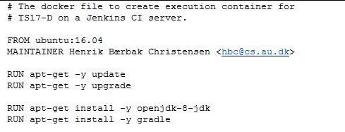
The Easy Part: Unit Test
Stage: BuildAndTest
Unit-test.sh
But
Require an ‘agent’ = execution context = docker container that includes Java8 and Gradle!
Thus you have to build that (or find it)

Slide 17
Service Tests
Tricky, in a Docker context

Slide 18
The Tricky Part
Service Tests / Integration Test / End-to-End test
Why?
Because they test TS17D connected to external services!
MongoDB, Mountebank, …
Issues
You cannot have the tests in the normal gradle structure (/test)
You need to start external services, i.e. ‘docker run’ from scripts
But – these scripts are within a docker container!
Thus – you need to install docker – in a docker container
You need a network
So ts17d can see a host that has MongoDB etc.

Slide 19
Issue 1: Gradle Integration tests
Integration (or manual) tests in Gradle
Default ‘gradle test’ will execute everything in src/test ☹
Requires
Create new source set ‘src/integration’
Create ‘integration’ task which runs as JUnit test all tests defined in ‘src/integration/test’
Major gradle magic
https://www.petrikainulainen.net/programming/gradle/getting-started-with-gradle-integration-testing/

Slide 20
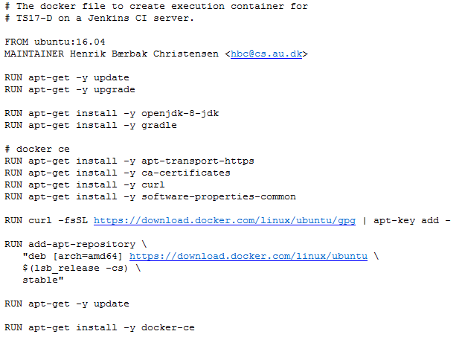
Issue 2: Starting Containers
Start docker containers – inside a docker container ???
Yes, you need to
Install ‘docker ce’ in the jenkins agent container
Mount the docker socket
Notes:
The Dockerfile creates henrikbaerbak/jenkins-build once and for all which is published on docker hub. This container has docker ce installed. The pipeline agent starts that as jenkins agent; as this has mounted the docker socket using the –v argument, all docker commands issued FROM the jenkins-build container are NOT communicating with the LOCAL (in container) docker daemon but that of the HOST. As the HOST is the Jenkins container and this was ALSO started with the same –v argument it will map all the out to the real physical computers docker server – thus we can inside the agent inside the Jenkins actually start docker containers on the physical host. This is done in the ‘start-external-services.sh’ which is started from the Jenkins file.

Slide 21
Issue 3a: Networking
Network for TS17D that has e.g. MongoDB deployed
No! You cannot use portmapping for this (argue why)
Solution: Named networks in docker
On Physical HOST ‘docker network create ci’

Slide 22
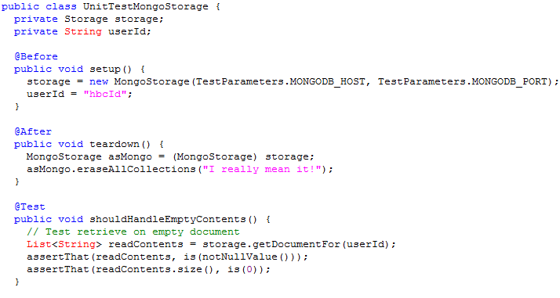
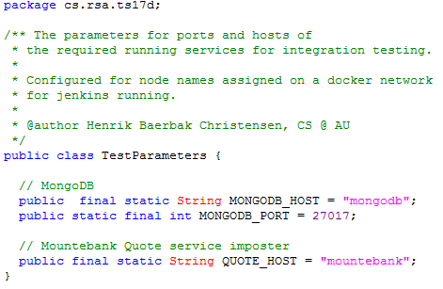
Issue 3b: Networking
All containers on network ‘ci’ can see each other under the name assigned to the container
mongodb:27017 is db server on container mongodb
mountebank:6777 is imposter quote service

Slide 23
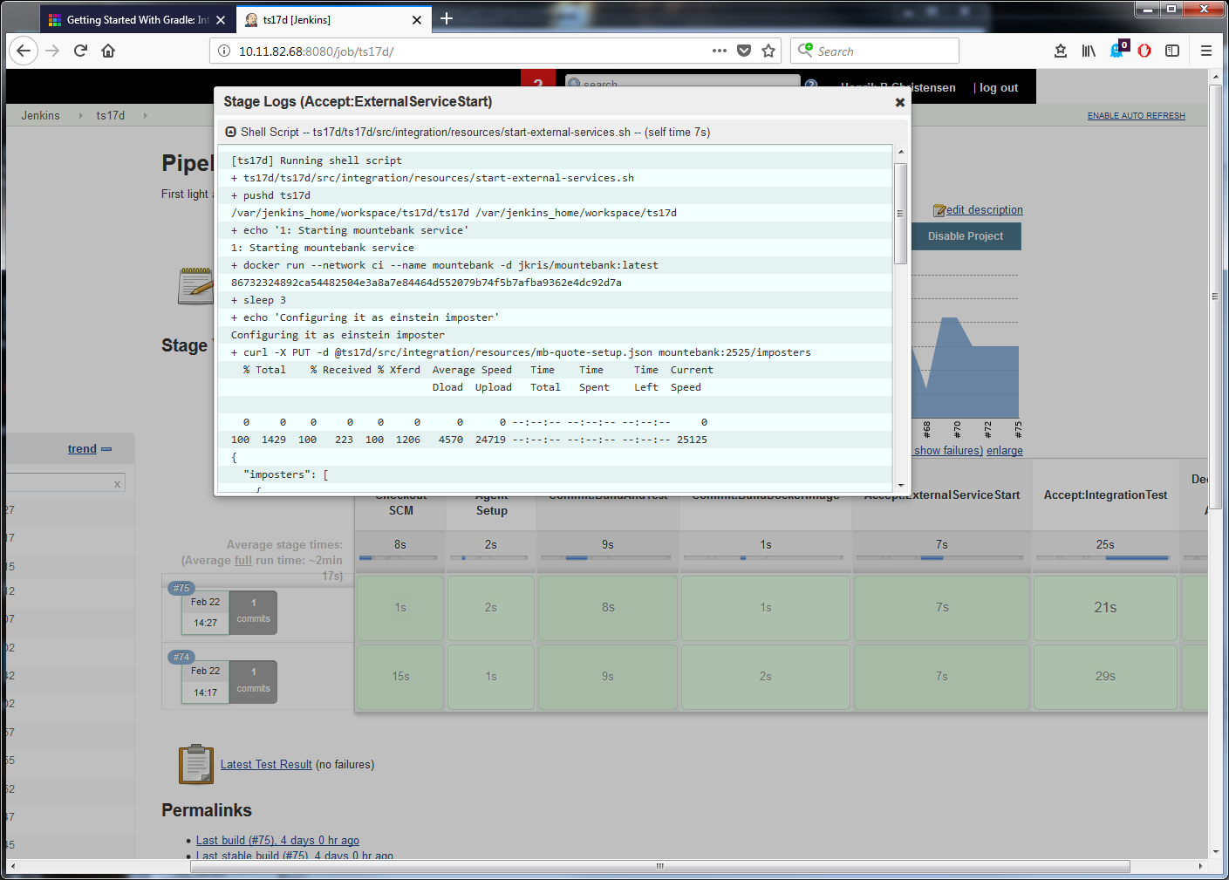
Phew…
This was a long journey…

Slide 24
Release

Slide 25
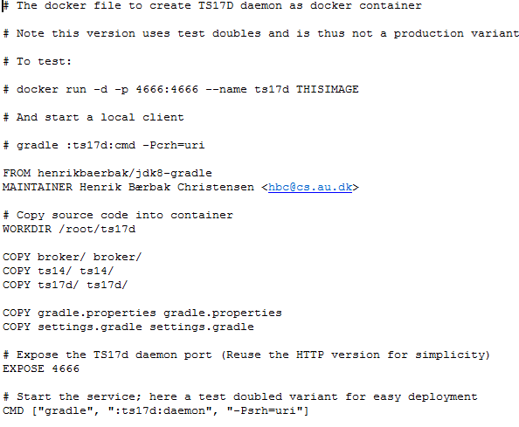
Jez Humble: Commit Stage
Recall: Commit stage
Compile code, run unit tests, create binaries for later stages
Docker context
Build an image for TS17D
Note: This image actually builds from source code! Binary distribution pending

Slide 26
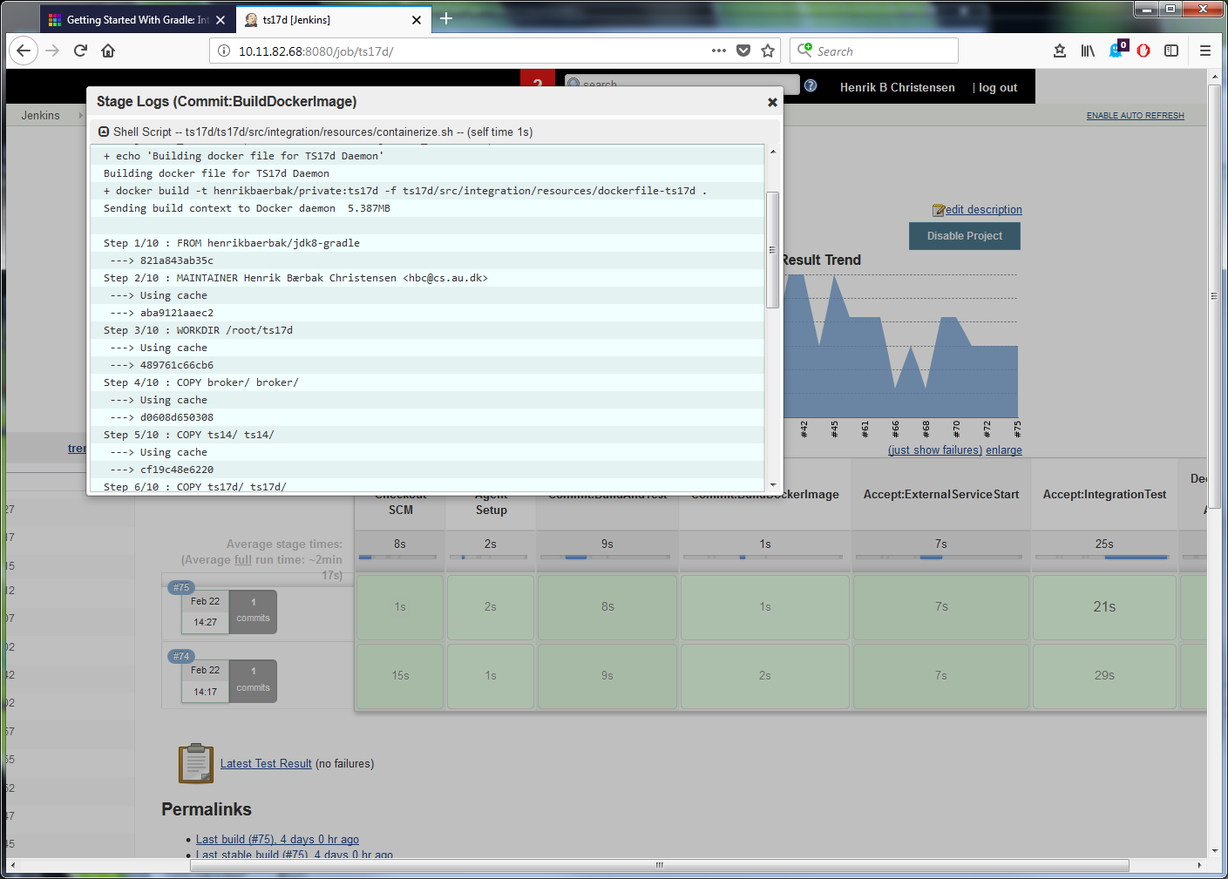
Docker build

Slide 27
Deploy to Production

Slide 28
Hmmm…
I have not done it…
Use Droplet API, use AWS API, etc, from a shell script in a stage in Jenkinsfile
Or
Uber uDeploy and uOrchestrate
…
Or
Rancher/Kubernetes/whatever UI

Slide 29
Monitoring / Jenkins UI

Slide 30
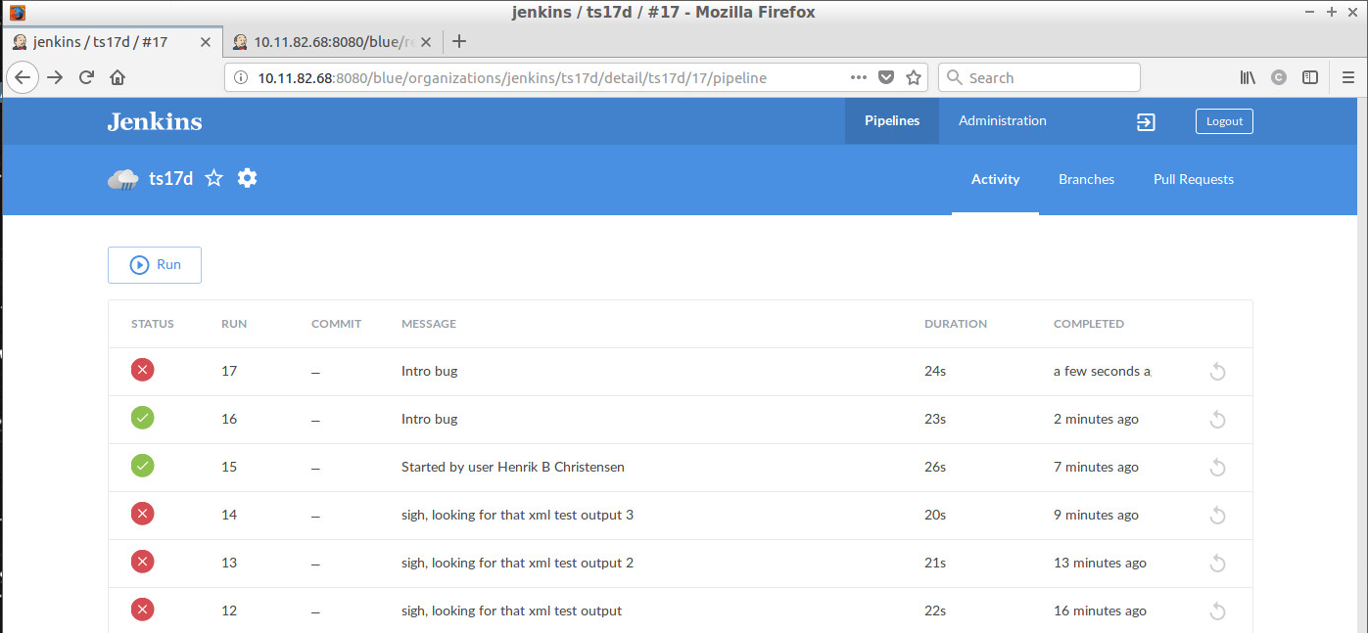
GUI # 2: Blue Ocean

Slide 31
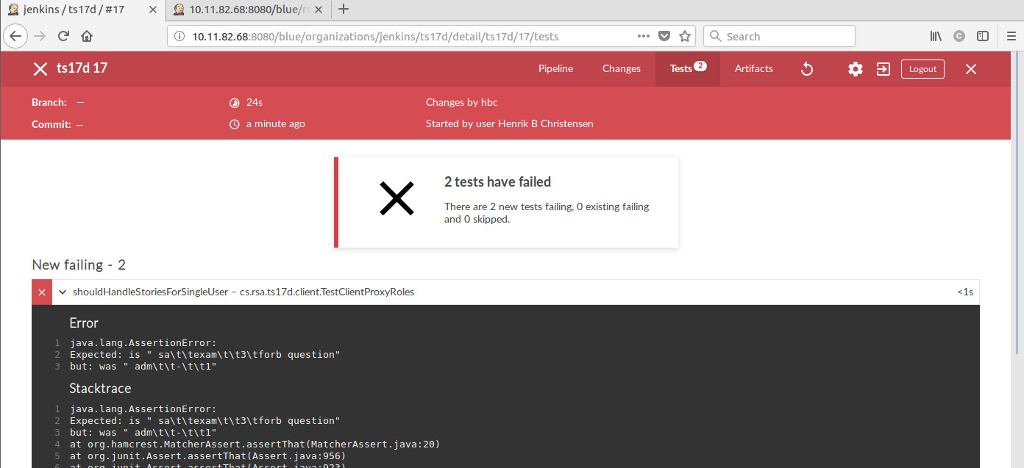
Failed Test cases
Jenkins can fetch JUnit reports

Slide 32
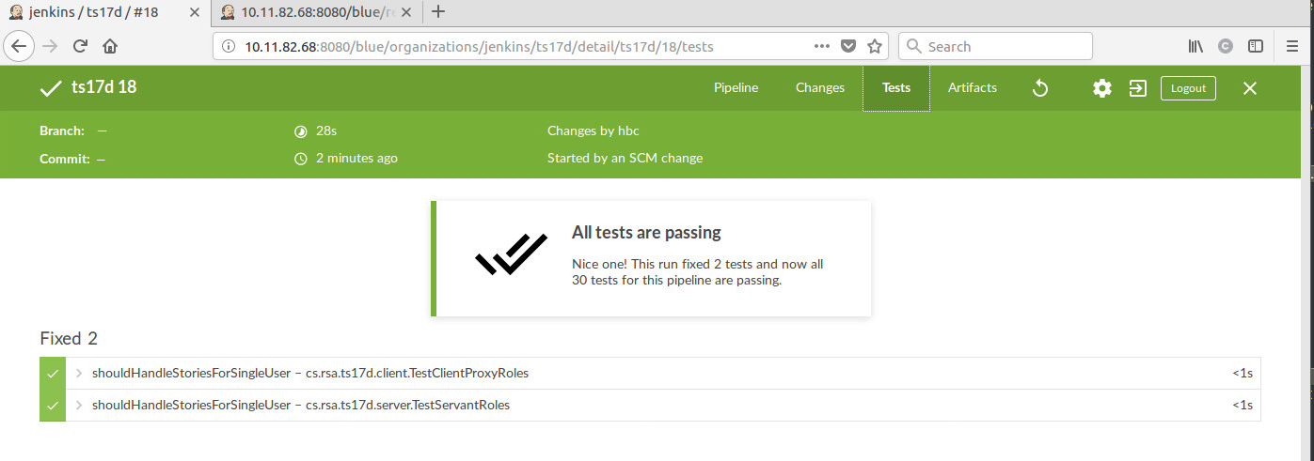
Back On Track

Slide 33
Discussion

Slide 34
Discussion
Lots and lots of hard bindings ☹
Language mix (Jenkins+Shell) instead of dedicated DSL
And ‘something else’ for Windows…
Lots of magic constants, no means of abstraction
Jenkins refers to named shell scripts
Scripts refers to named images, resources, …
Identical names in the JUnit test code
Quite a few environmental dependencies
Proper setup of Jenkins container, agent containers
Dependency on previously made docker network
Consistency! Refactoring!

Slide 35
Discussion
Slow development turn around
Fail? Change a bit, commit, and push, and hit ‘build now’ in Jenkins, and review
Slow and manual
Pollute git branch with stupid commits ala “does this work then???”
Ex: Change ‘--ti’ to ‘-ti’, commit, push, jenkins build, review failure…
Differences in environment (jenkins/manual)
Can I just run the integration test scripts? No!
Hard couplings to special environment in Jenkins

Slide 36
Discussion
The evolutionary model is much too visible
Two different GUIs
Classic and ‘Blue Ocean’ look very different
Jenkins file can be in one of two different formats
Scripted and Declarative
Pipelines can be created using the GUI alone
Which means:
Every tutorial/guide you find on the net explains the solution to your problem using another specification model than the one you have adopted!!!

Slide 37
Discussion
The documentation issue…
I have unfortunately seen this issue very often
Superficial tutorial material
Explaining 10% using non-relevant examples
“No, I will not use Jenkins to echo ‘This is stage 1’ onto the terminal!!!”
Combined with reference material suitable for experts only
Took a lot of effort to crack the ‘start some services’ nut…
Ant, Ivy, Gradle, Jenkins follow this unfortunate pattern

Slide 38
Conclusion
Mixed…
The concepts and motivation are ‘right’
The Jenkins tool is not IMO

Slide 39
Pipeline Syntax
Internal notes ☺

Slide 40
Where am I?
Point of confusion:
The folders involved, where is ‘current folder’ in Jenkins?
Given git project ‘rsa’ you will clone to ‘~/rsa’
Put Jenkinsfile in the project root ~/rsa/Jenkinsfile
In stages, files are referenced from this folder
Sh ‘ts17d/ci/test.sh’ if test.sh is in ~/rsa/ts17d/ci folder
In the shell scripts the same folder is the ‘current’
Pushd ts17d will change to ~/rsa/ts17

